Slide 1
RL Foundations
AI BootCamp

Slide 2
Outline
Introduction to Reinforcement Learning concepts
Markov Chains, Markov Decision Process (MDP)
State values (V) and State-Action values (Q), Bellman Equations
Review of current algorithms

Slide 3


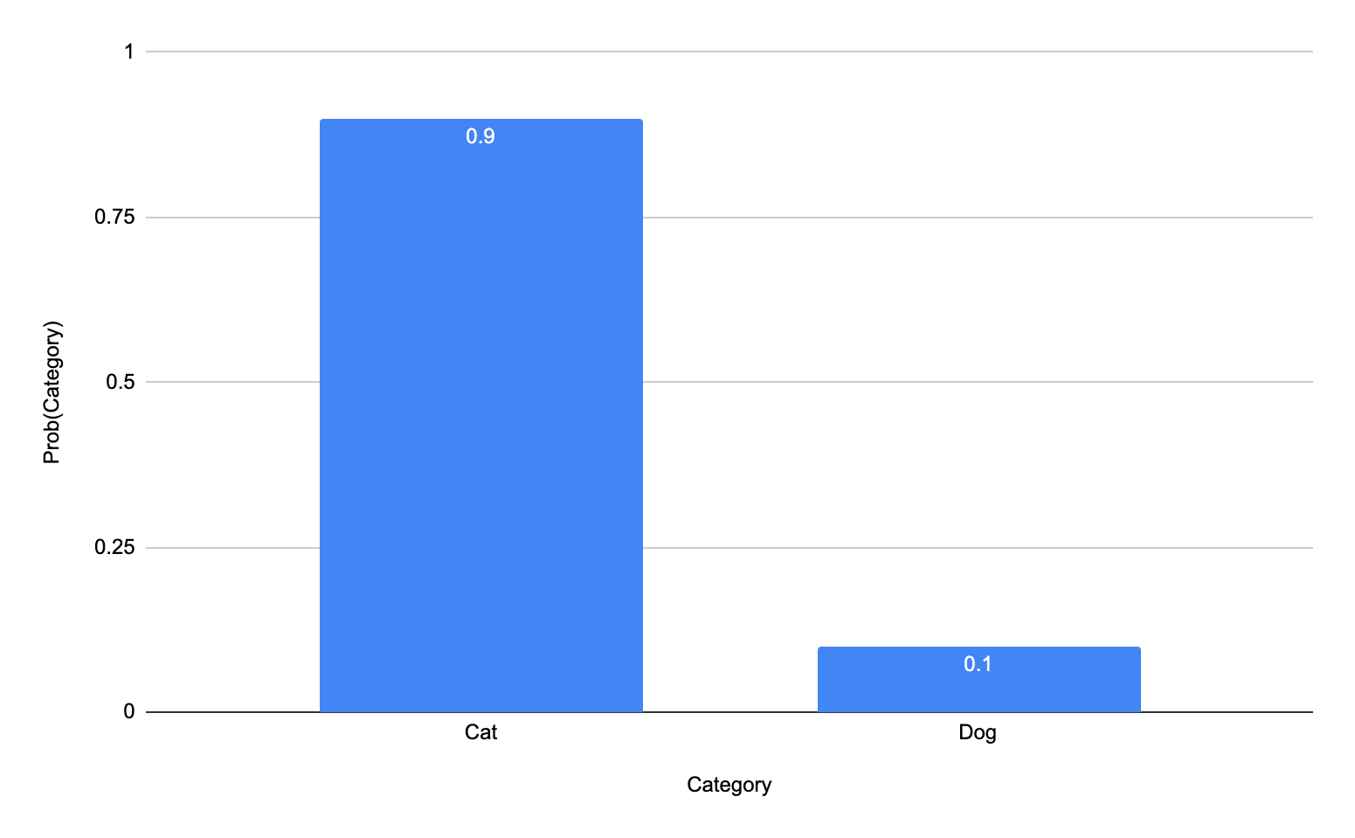
Supervised learning way
Input - Samples of labeled data
Output - probability distribution over categories
For supervised learning we need labeled data

Slide 4
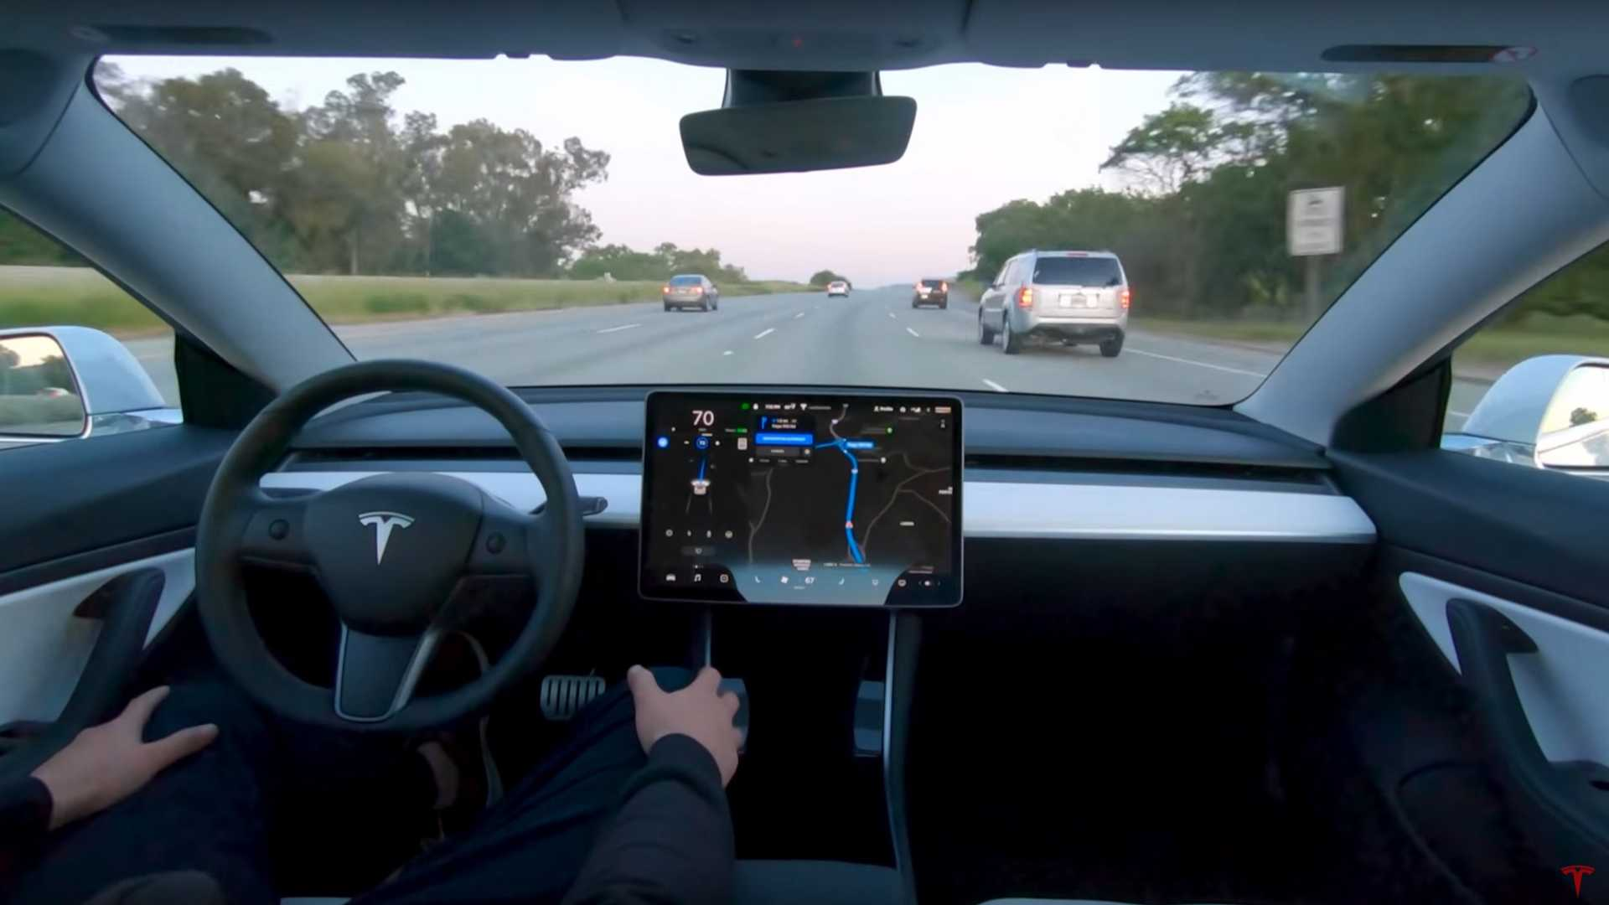
Supervised learning: Self driving car
How to formalize self driving car problem in the terms of supervised learning?

Slide 5
RL tasks
Self-driving car
Autonomous drones
Playing video games
Robotics
Autopilot
Multi Armed bandits
etc

Slide 6
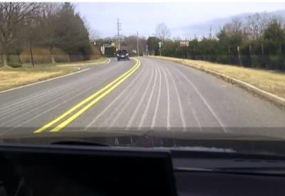

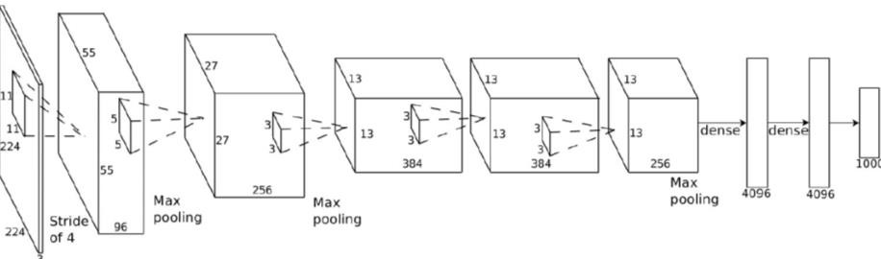
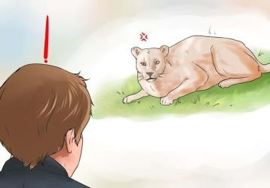




Learning from expert: Imitation learning
Input - Samples of labeled data (labels are actions)
Output - probability distribution over actions
Build neural network that learns from human expert (Imitation learning, Behavioral coling)

Slide 7
Problems with Imitation learning
Biased data - Every person drives in certain way
Unseen data - Impossible to capture every possible state, especially rare ones
Compounding error - Error of the model compounds over time

Slide 8
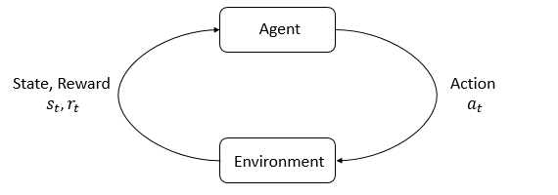
RL terminology - Agent and Environment
Environment - Is the world that the agent lives in and interacts with.
Agent - Entity that at every step of interaction, receives state of the world from environment, and then decides on an action to take.

Slide 9
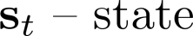
States
A state s is a complete description of the state of the world. There is no information about the world which is hidden from the state.
for self-driving car will be camera input at time t
When only partial observation is available, we say that the environment is partially observed.

Slide 10
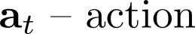
Action spaces
The set of all valid actions in a given environment is often called the action space.
E.G for self driving car action space will be:
Turn (left, right)
Throttle control (increase, decrease)
Light control (headlight, taillight, etc)

Slide 11
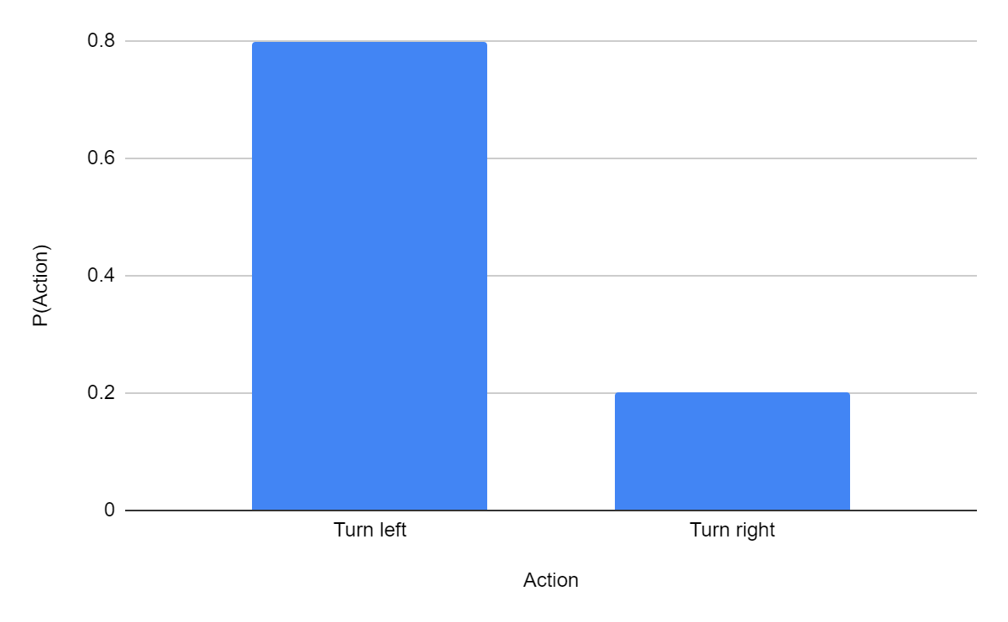
Policy
Policy is a rule used by an agent to decide what actions to take
Usually discrete policy is a probability distribution over possible actions

Slide 12

Reward
Reward is a numerical signal sent by the environment to the model that tells which action is better or worse
In supervised learning “training signal” was provided by the label.
In RL reward is the basis for “training signal”

Slide 13
Let’s imagine daily commute to work as episode in RL

Slide 14
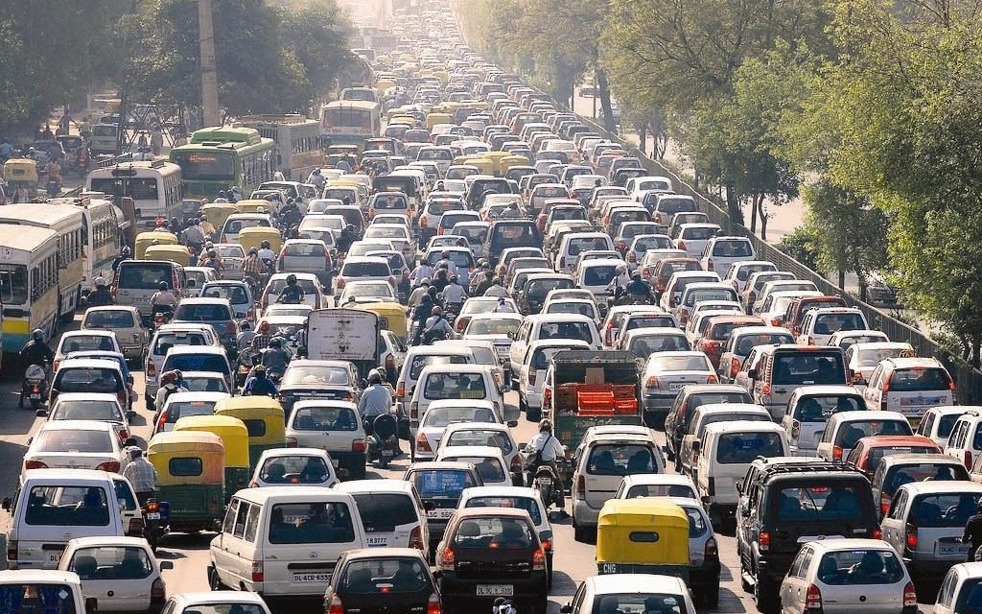
Reward: -2

Slide 15
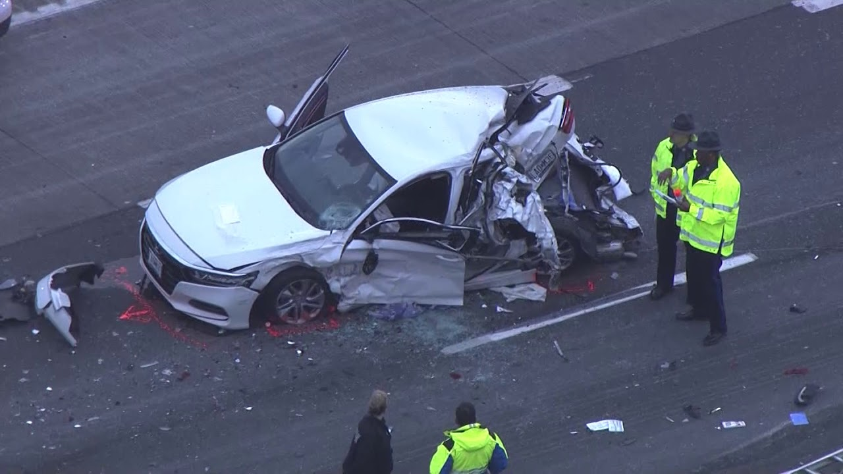
Reward: -5

Slide 16
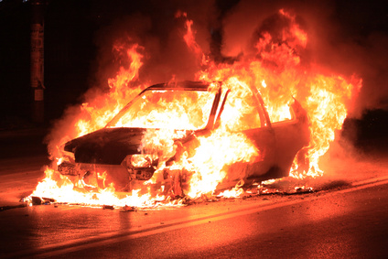
Reward: -100

Slide 17

Reward: +10

Slide 18
Reward: +10 - 10

Slide 19

Reward: -40

Slide 20
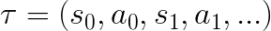
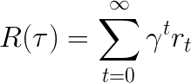
Episode/Trajectory, Return
Trajectory or Episode is a sequence of states and actions in the environment
Return is a cumulative reward over the trajectory

Slide 21
Putting together

Slide 22
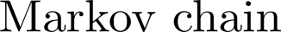
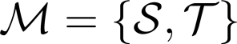
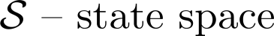
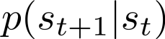
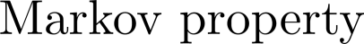
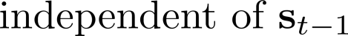
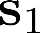
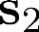
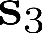
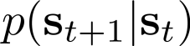
Markov chain definitions

Slide 23
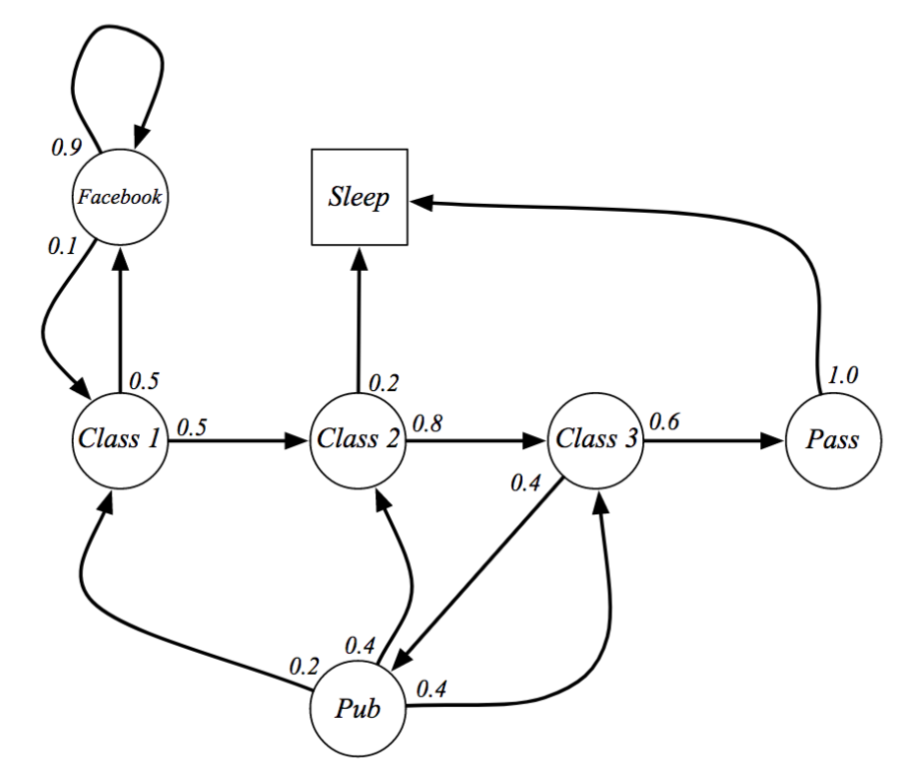
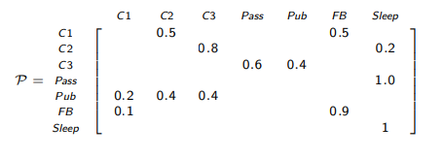

Slide 24
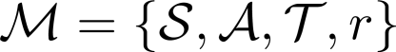
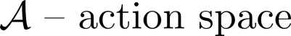
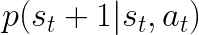
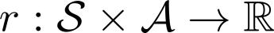
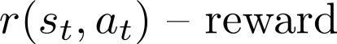
Markov Decision process
In practice transition function is unknown

Slide 25
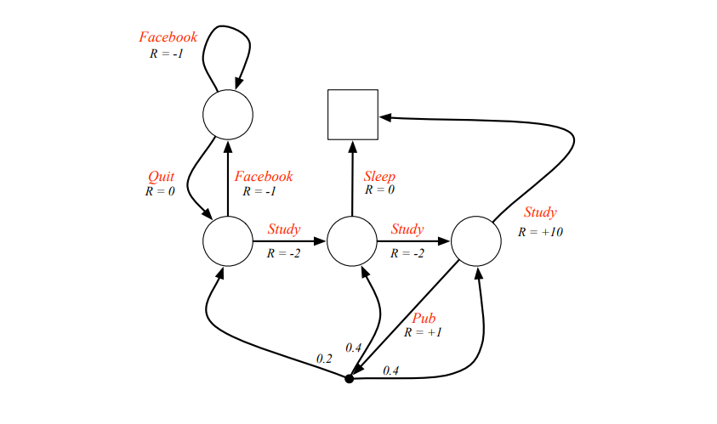

Slide 26
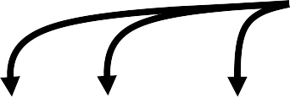
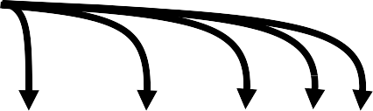

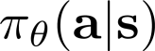
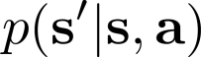
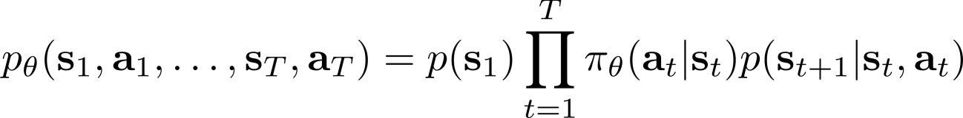
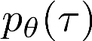
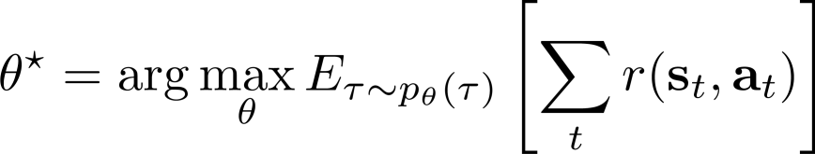
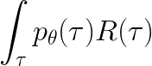
The goal of reinforcement learning
Hard to estimate

Slide 27
Questions
How do we know that certain state is more valuable than the other?
How do we know that certain action in some state is the best
We found a way to solve 1 and 2. How do we solve MDP?

Slide 28
Break

Slide 29
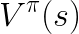
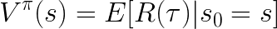
The state-value function of an MDP is the expected return
starting from state s, and then following policy
The action-value function is the expected return
starting from state s, taking action a, and then following policy

Slide 30
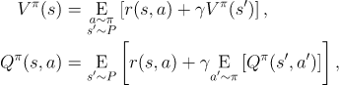
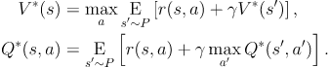
Bellman equations
The value of your starting point is the reward you expect to get from being there, plus the value of wherever you land next
The Bellman equations for the optimal value functions

Slide 31
Questions
We found a way to estimate Q(s,a) values for whole MDP. How we choose best policy?
How this equation can be used to solve MDP?

Slide 32
Types of RL algorithms
Policy gradients: Directly differentiate objective
Value-based: Estimate value function or Q-function of the optimal policy (no explicit policy)
Actor-critic: Combination of the above
Model-based RL: Build model of the world before optimizing
Intrinsic reward RL : Doesn’t provide reward explicitly
Inverse RL: Learn the reward function from expert
Imitation learning: Clone the expert
Hierarchical learning: Learn low and high level abstractions/actions
Multi-Agent, Cooperative, Evolutionary algorithms, Tree based , methods ….

Slide 33
Different tradeoffs
Sample efficiency
Stability & ease of use
Different assumptions
Stochastic or deterministic?
Continuous or discrete?
Episodic or infinite horizon?

Slide 34
Sample efficiency = how many samples do we need to get a good policy?
Most important question: is the algorithm off policy?
Off policy: able to improve the policy without generating new samples from that policy
On policy: each time the policy is changed, even a little bit, we need to generate new samples

Slide 35
off-policy
on-policy
More efficient (fewer samples)
Less efficient (more samples)
model-based
shallow RL
model-based
deep RL
off-policy Q-function learning
actor-critic style methods
on-policy policy gradient algorithms
evolutionary or gradient-free algorithms

Slide 36
References/Useful resources
Books
Reinforcement Learning - An Introduction by Sutton
Algorithms for Reinforcement Learning
Videos
Short introduction to Tensorflow and fundamentals of RL (BESssssssssT VIDEO)
Arxiv Insights - A channel for a quick intro to papers on RL and GAN
Playlist from DeepMind by David Silver, good intro for core concepts
More practical videos on RL
OpenAI - Spinning Up in Deep RL Workshop
Courses/Tutorials
Useful for understanding core algorithms in RL and many links to key papers
Practical RL - Course from Yandex
Useful resources
Comprehensive list of RL resources
Collection of papers for MARL

